Slide 1
8-3 Applications to Physics and
Engineering

Slide 2
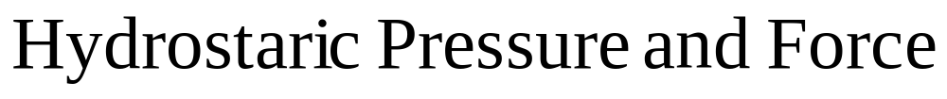
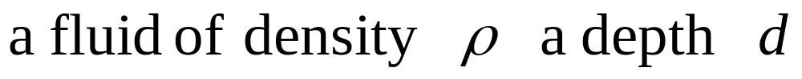
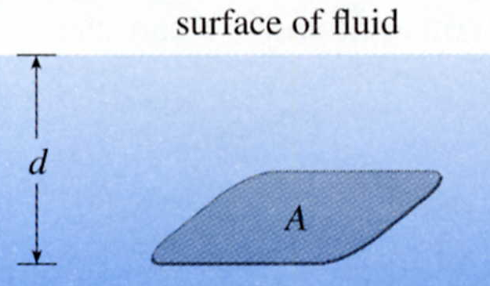
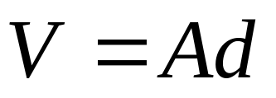
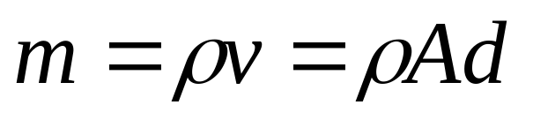
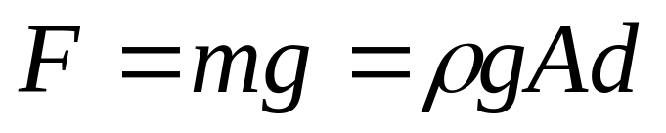
Deep-sea divers realize that water pressure increases as they dive deeper.
Surface of fluid
d
A

Slide 3
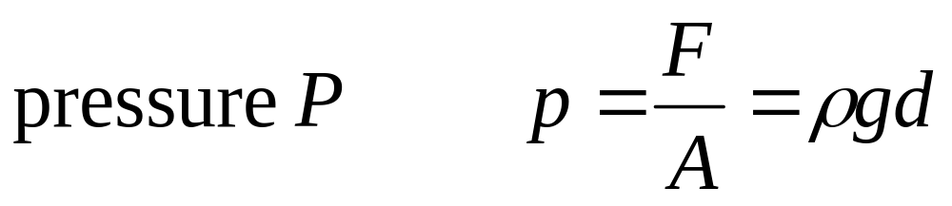
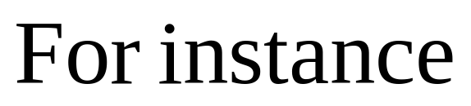
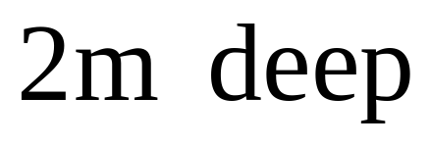
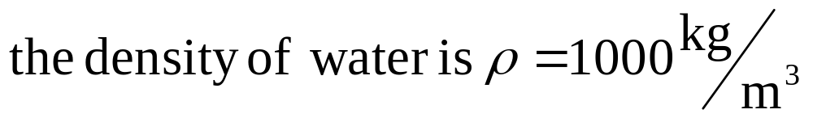
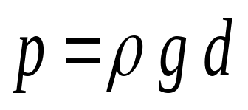
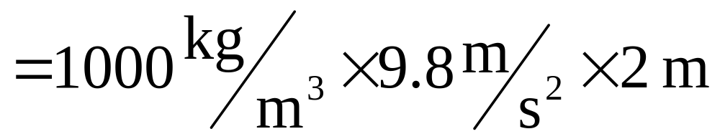
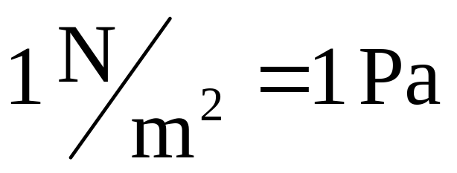
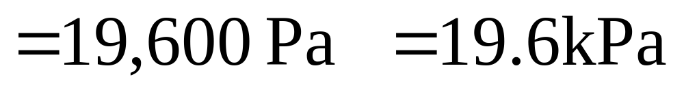
∵
∴

Slide 4

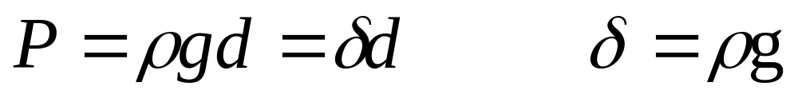
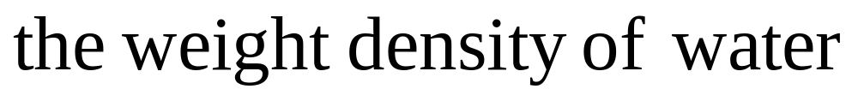
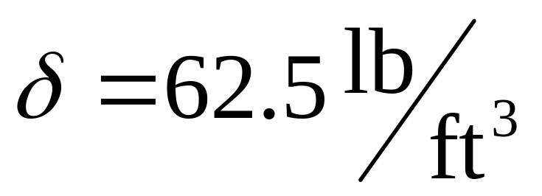

Slide 5
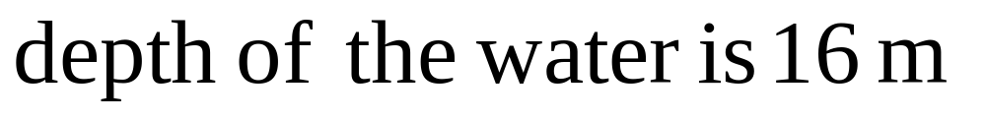
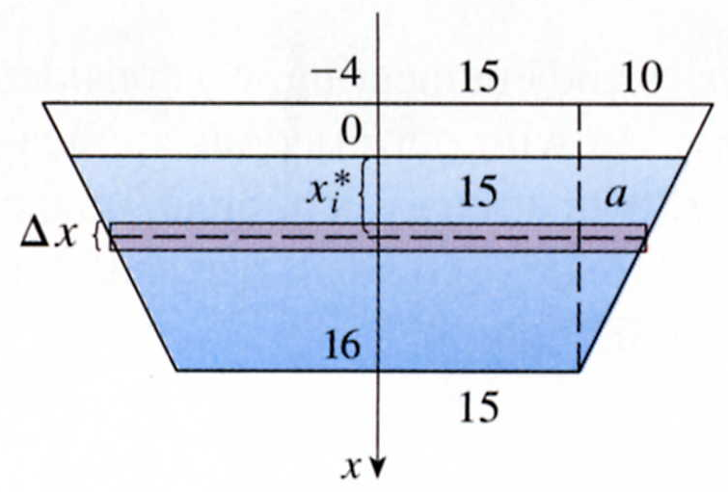
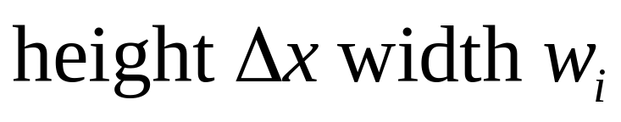

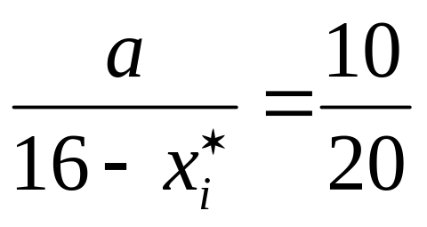
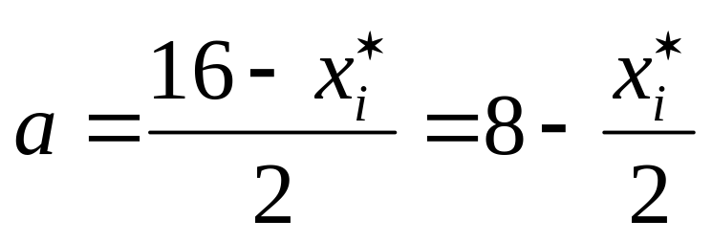
EXAMPLE 1
A dam has the shape of the traezoid shown in Figure 2. The height is 20 m, and the width is 50 m at the top and 30 m at the bottom.
Find the force on the dam due to hydrostatic pressure if the water level is 4 m from the top of the dam.
SOLUTION
25
定座標
x_{i}*
△x
w_{i}/2
15
10
a
20
W_{i}= 2(15+a) = 46 - x_{i}*
16-x_{i}*

Slide 6
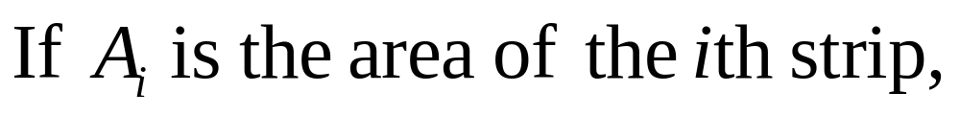
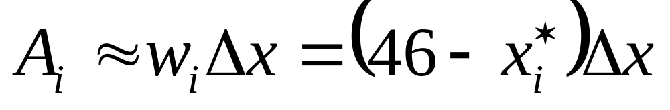
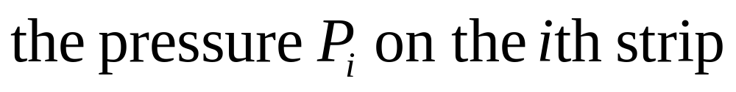
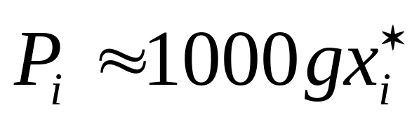
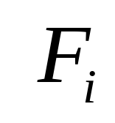
水深度
Hydrostatic force
= P_{i}A_{i}
≒ 1000gx_{i}*(46-x_{i}*)△x

Slide 7
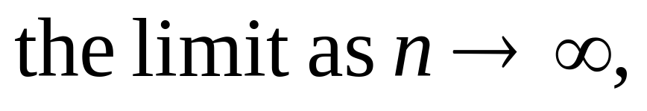
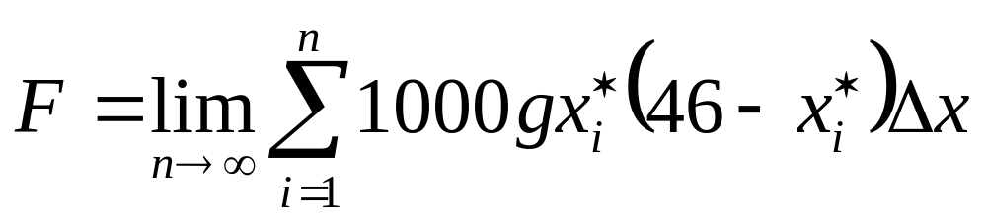
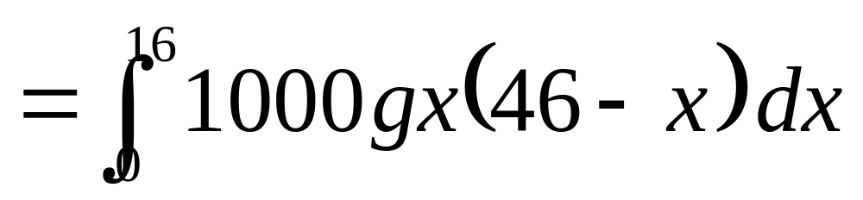
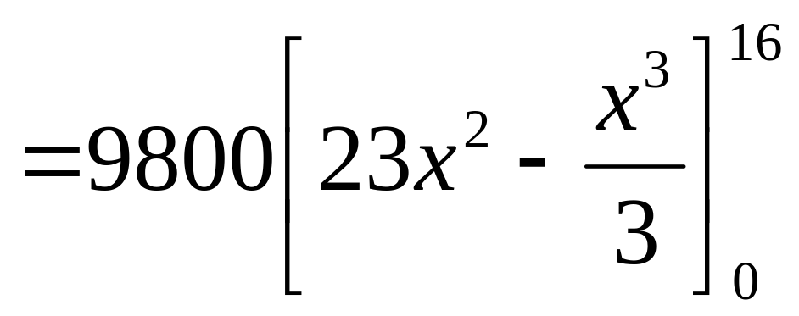
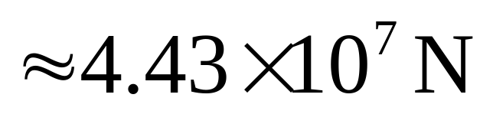

Slide 8


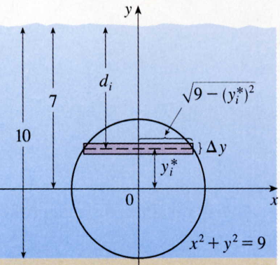

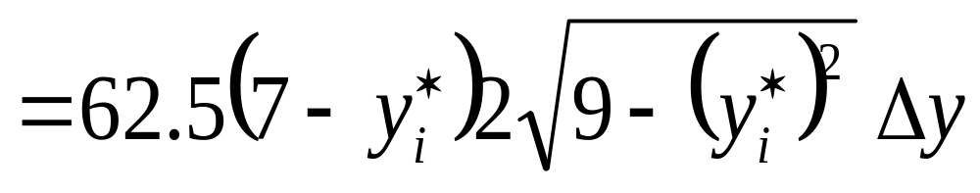
EXAMPLE 2
Find the hydrostatic force on one end of a cylindrical drum with radius 3 ft if the drum is submerged in water 10 ft deep.
SOLUTION
The length of the i th strip is, W_{i}=
The area of the i th strip is, A_{i}= W_{i}‧△y
取截面，寬度Ｗ_{i}
=
定座標
The pressure P_{i}
=
d_{i}
7
= 62.5(7- y_{i}*)
10
The force F_{i} = P_{i}‧A_{i}
3

Slide 9
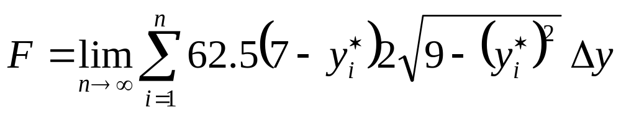
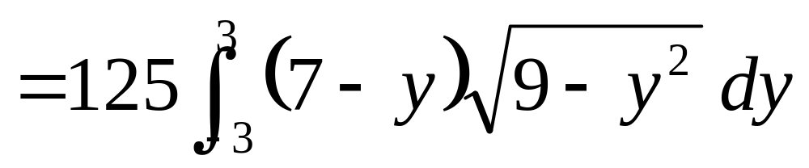
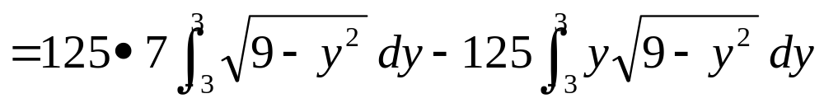
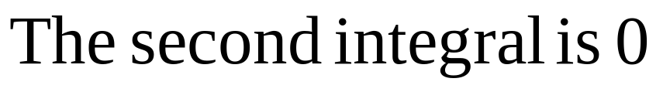
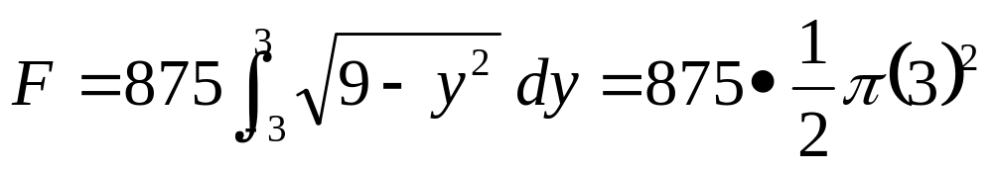
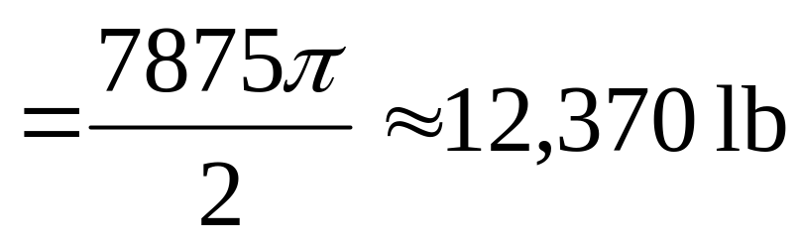
0

Slide 10
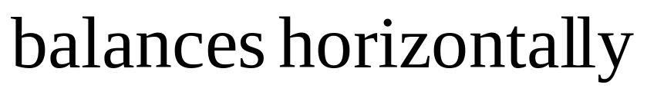
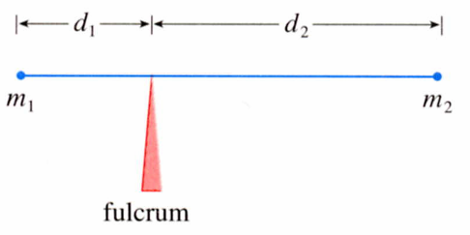
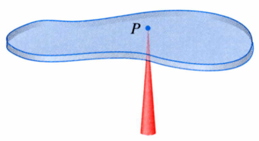
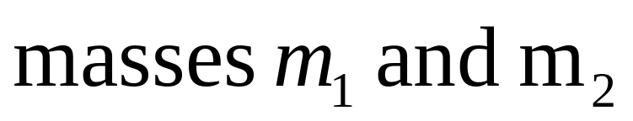
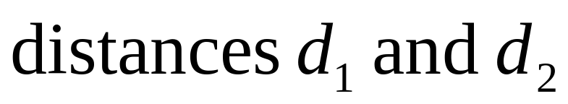
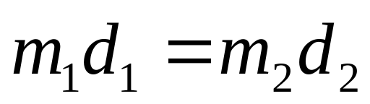
d₁
d₂
P
m₁
m₂
力矩平衡

Slide 11
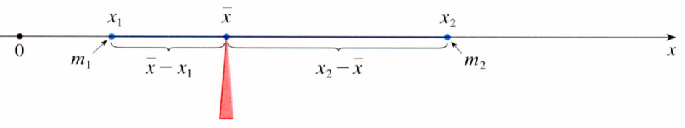
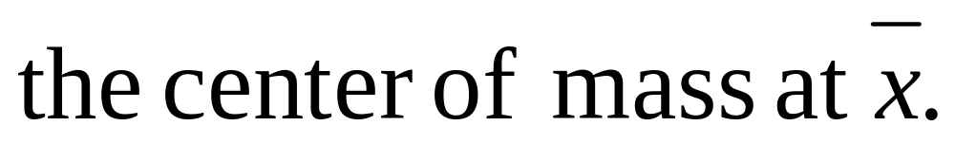
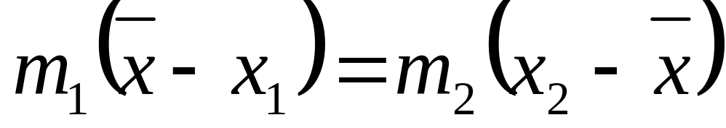


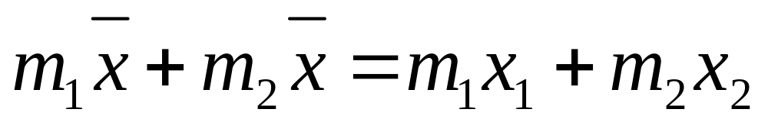

x₁
x
x₂
m₁
x
- x₁
x₂ -
x
m₂
x

Slide 12





moments
A
M =
= m x
Moment of the system about the origin.

Slide 13





A
Moment
Moment

Slide 14



(總質量)

Slide 15


EXAMPLE 3
Find the moments and center of mass of the system of objects that have masses 3,4, and 8 at the points (-1,1),(2,-1), and (3,2).
SOLUTION
M_{y}= 3(-1) + 4(2) + 8(3) = 29
M_{x}= 3(1) + 4(-1) + 8(2) = 15
m= 3+ 4+ 8 = 15
M_{y}
X =
= 29/15
m
M_{x}
y =
= 15/15
m

Slide 16






Consider
(質量中心)
If

Slide 17

Moments defined
The entire mass is concentrated at the center of mass, and moments remain unchanged.
The moment of the union of two non- overlapping regions, should be the sum of the moments of the individual regions.

Slide 18


y=f(x)
f is continuous function, divide the interval [a, b] into n subintervals with endpoints x₀,x₁,…,x_{n}, and equal width △x.
a
b
The midpoint x_{i} of the ith subinterval x_{i} =(x_{i-1} + x_{i})/2
(x_{i}, f(x_{i}))
The centroid of the ith approximating rectangle R_{i} is its center C_{i}( x_{i}, 1/2 f(x_{i}))
a
b
The area is f(x_{i}) △x,
The mass is f(x_{i})△x
X_{i-1}
X_{i}
X_{i}

Slide 19




x_{i}

Slide 20





Slide 21







EXAMPLE 4
Find the centroid of mass of a semicircular plate of radius r.
SOLUTION
y
dx
Centroid of mass

Slide 22






EXAMPLE 5
Find the centroid of the region bounded by the curves y= cosx, y= 0, x= 0, and x= /2.
SOLUTION
x
dx

Slide 23





C_{i}( x_{i}, ½[f(x_{i}) + g(x_{i})] )
f
f- g
(f- g)/2
(f+ g)/2
g

Slide 24












EXAMPLE 6
SOLUTION
x= 0, x= 1

Slide 25
Theorem of Pappus
Let R be a plane region that lies entirely on one side of a line L in the plane.
If R is rotated about L, then the volume of the resulting solid is the product of the area A of R and the distance d traveled by the centroid of R.
V = A X d

Slide 26







Proof
R繞y軸旋轉一圈
The
x
A
x
a
b

Slide 27





EXAMPLE 7
A torus is formed by rotating a circle of radius r about a line in the plane of the circle that is a distance R ( r) from the center of the circle. Find the volume of the torus (甜甜圈).
SOLUTION
R
r

Slide 28
8-3 Exercises
EX7 , EX29

